Slide 1
RATIO BACK SPREADS
Hare Krishna Mitra
OC Traders
Dec 03, 2011

Slide 2
TRADING DISCLAIMER
All TRADING involves high risk and YOU can LOSE a substantial amount of money, no matter what method you use. All trading involves high risk; past performance is not necessarily indicative of future results.
Commission Rule 4.41(b)(1)(I) hypothetical or simulated performance results have certain inherent limitations. Unlike an actual performance record, simulated results do not represent actual trading. Also, since the trades have not actually been executed, the results may have under- or over-compensated for the impact, if any, of certain market factors, such as lack of liquidity. Simulated trading programs in general are also subject to the fact that they are designed with the benefit of hindsight. No representation is being made that any account will or is likely to achieve profits or losses similar to those shown.

Slide 3
AIM
To profit from Directional Move (Vega Explosion)
Get paid(tiny) for your efforts even if the Move is totally against the anticipated direction
RISK
There could be substantial loss (Max risk is known) at a particular price zone
This risk could be avoided(compensated) with proper trade management (ex: Gamma Scalping)

Slide 4
CALL Ratio Back Spread
Unlimited Profit for CRBS
Buy ‘m’ number of calls
Profit capped for Vertical Spread
Sell ‘n’ number of calls
Credit for CRBS
Debit for v. Sprd
Debit for vanilla calls
‘n’ calls are nearer to the money
‘m’ calls are farther to the money
Net effect is a Tiny Credit

Slide 5
PUT Ratio Back Spread
Buy ‘m’ number of puts
Sell ‘n’ number of puts
‘m’ > ‘n’
‘n’ puts are nearer to the money
‘m’ puts are farther to the money
Net effect is Tiny Credit

Slide 6
RBS Structure
Choose the ratio so as to make a credit RBS
109
Buy 3 calls
Call RBS
Net Credit
105
Sell 2 calls
101
Current Price
90
Sell 3 puts
Put RBS
Net Credit
78
Buy 4 puts

Slide 7
Call RBS & Put RBS
Danger Zones (consider Gamma Scalping)

Slide 8
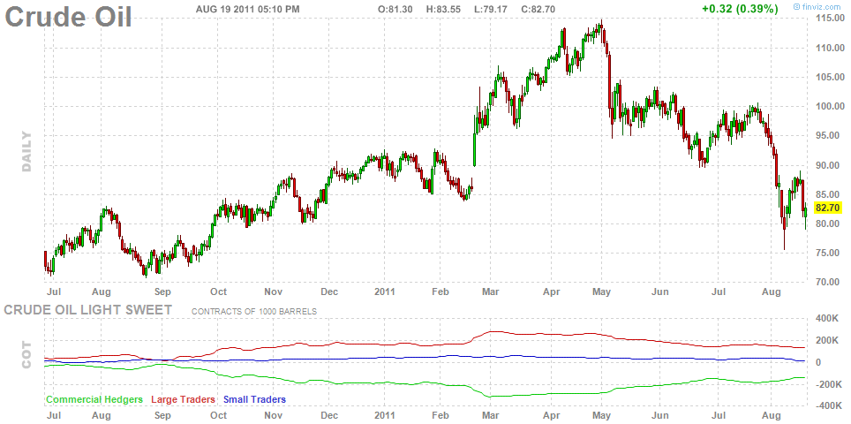
Crude Oil

Slide 9
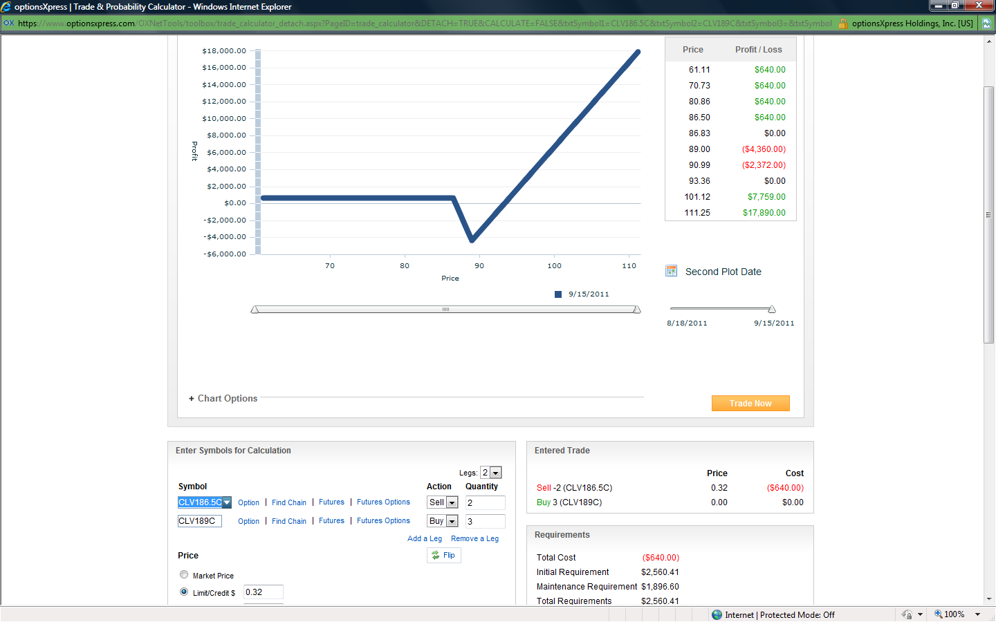
Crude Oil
Call Ratio Back Spread
Notes:
Symbol Bid Ask IV
CLV186.5C 2.32 2.54 46.03
CLV189C 1.40 1.63 43.32

Slide 10
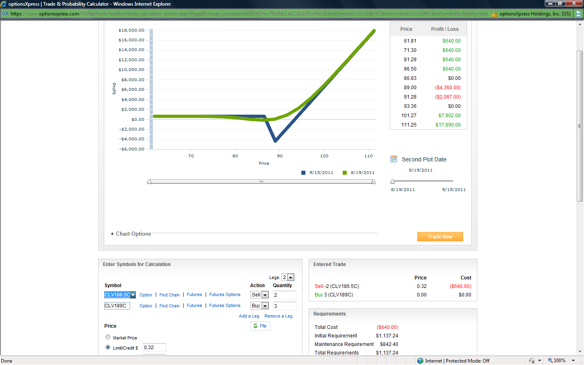
Crude Oil
Call Ratio Back Spread

Slide 11
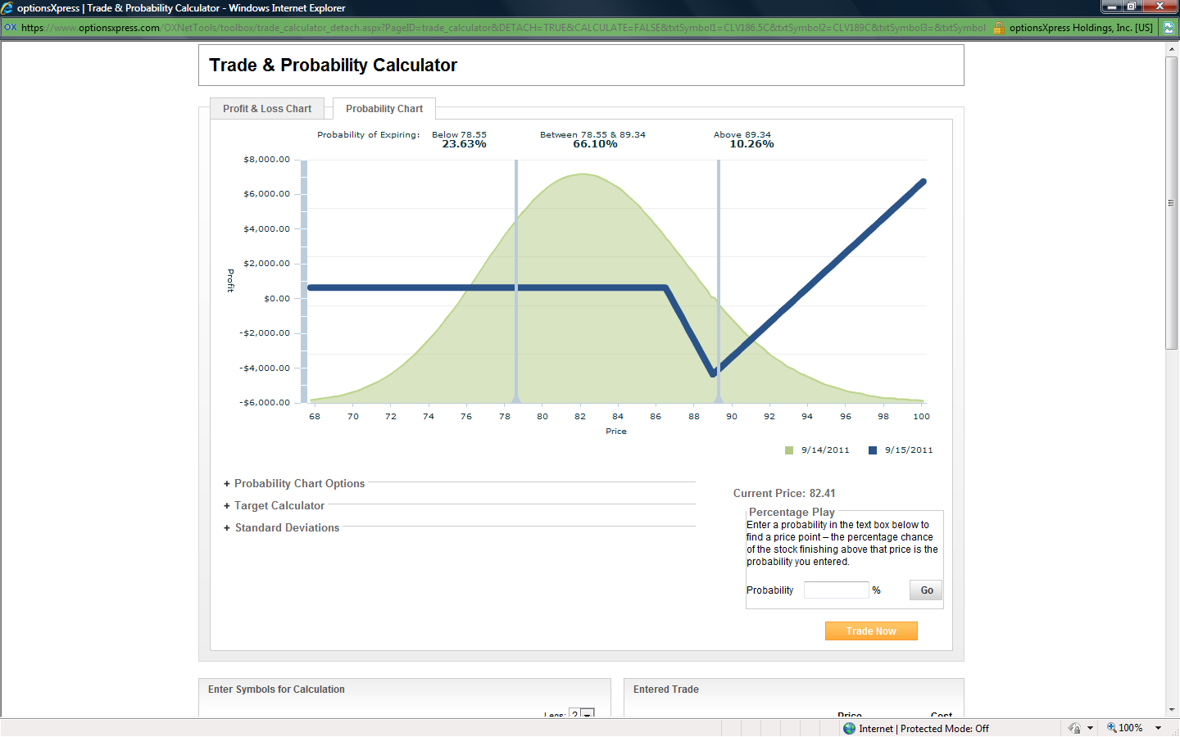
Crude Oil
Call Ratio Back Spread

Slide 12
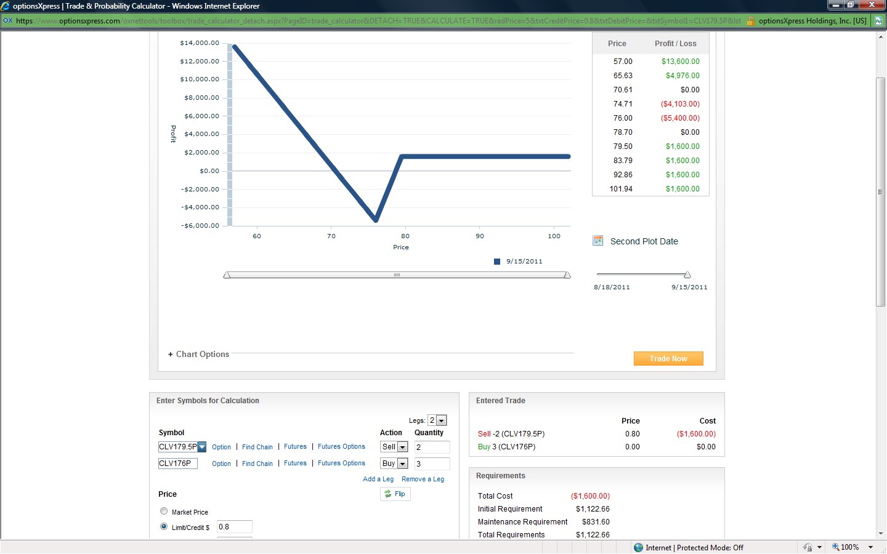
Crude Oil
Put Ratio Back Spread
Notes:
Symbol Bid Ask IV
CLV179.5P 3.12 3.35 53.08
CLV176P 0.40 0.00 22.78

Slide 13
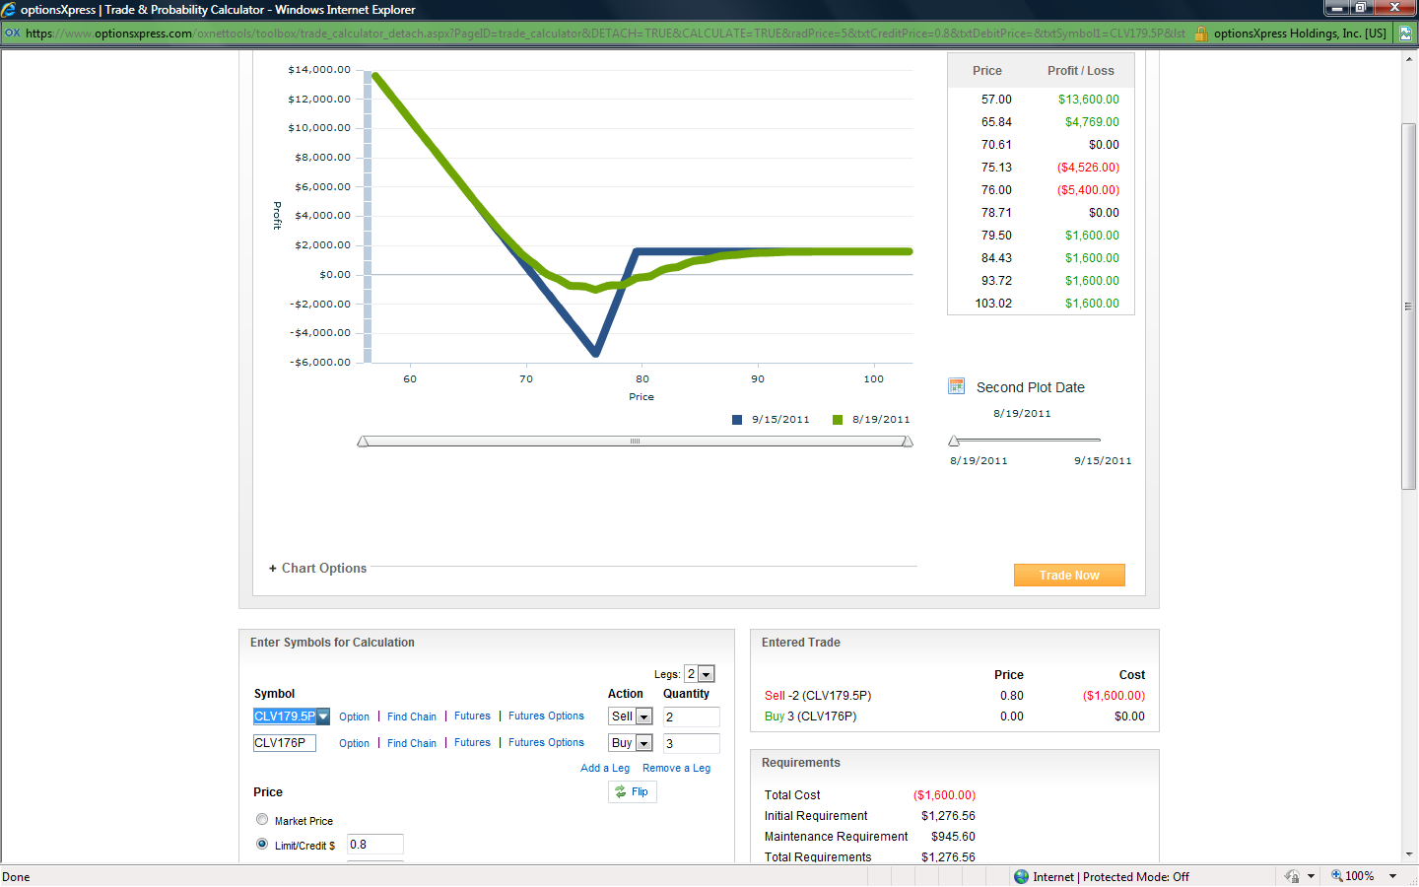
Crude Oil
Put Ratio Back Spread

Slide 14
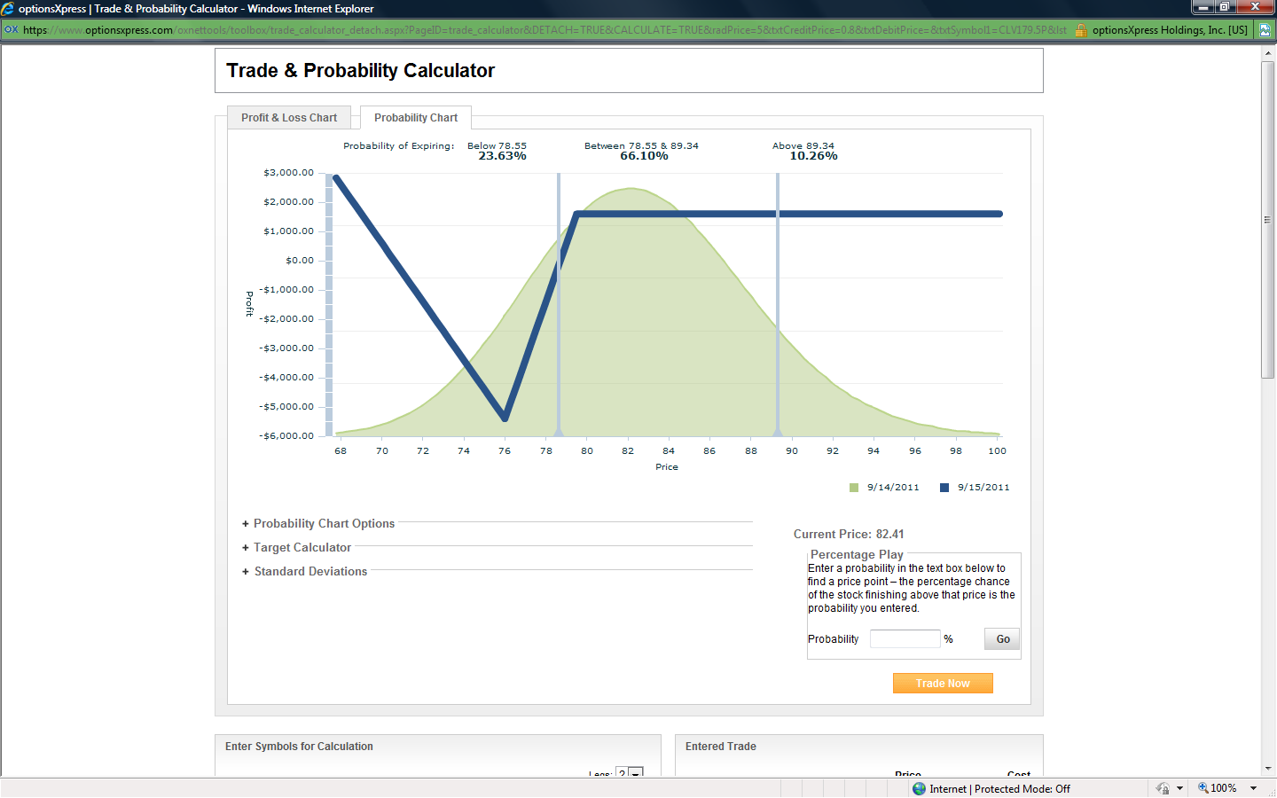
Crude Oil
Put Ratio Back Spread

Slide 15
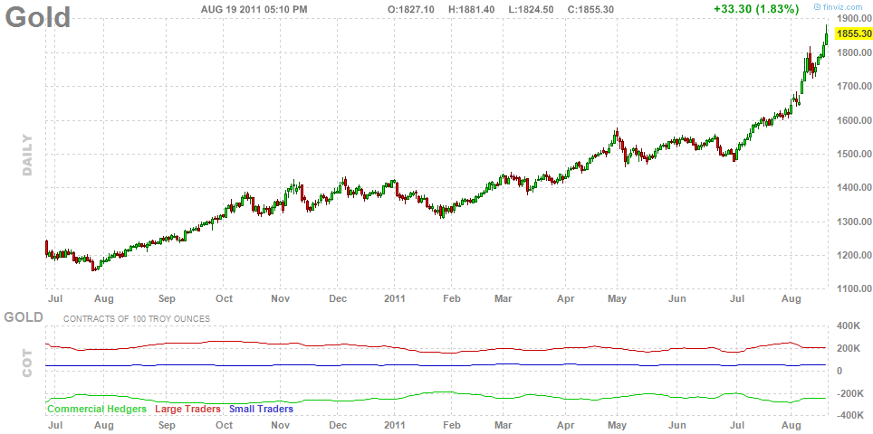
Gold

Slide 16
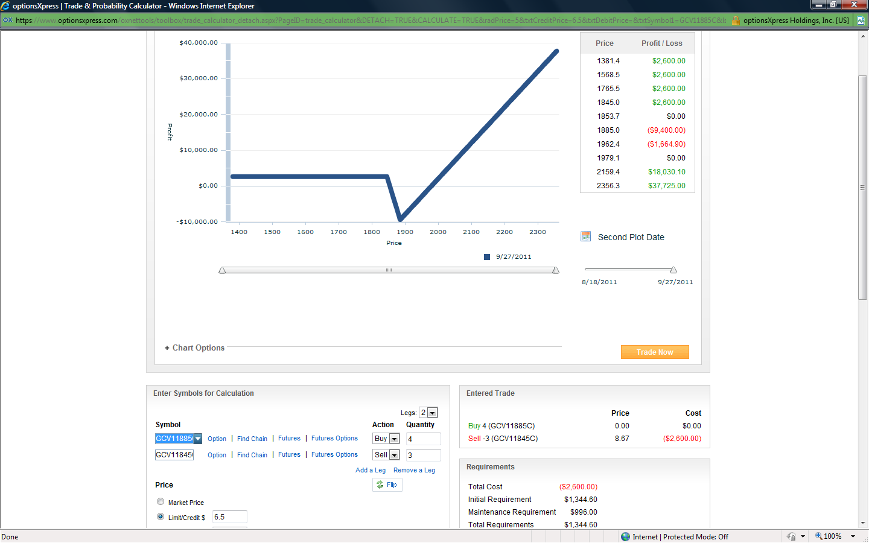
Gold
Call Ratio Back Spread
Notes:
Symbol Bid Ask IV
GCV11885C 45.20 49.00 25.92
GCV11845C 19.50 0.00 2.33

Slide 17
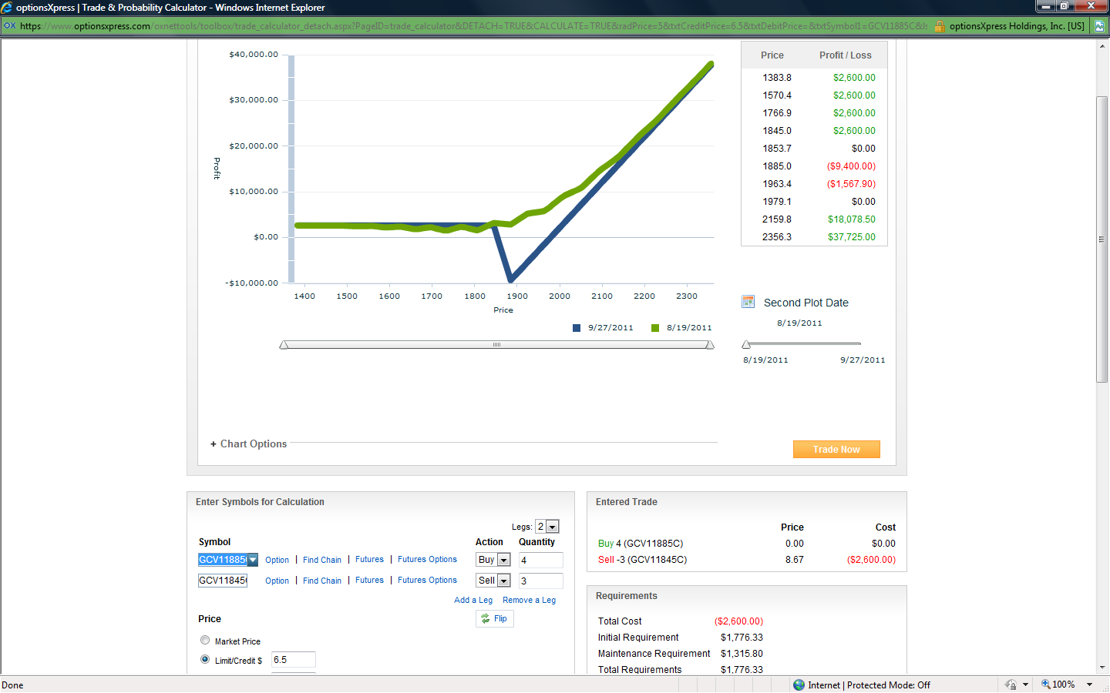
Gold
Call Ratio Back Spread

Slide 18
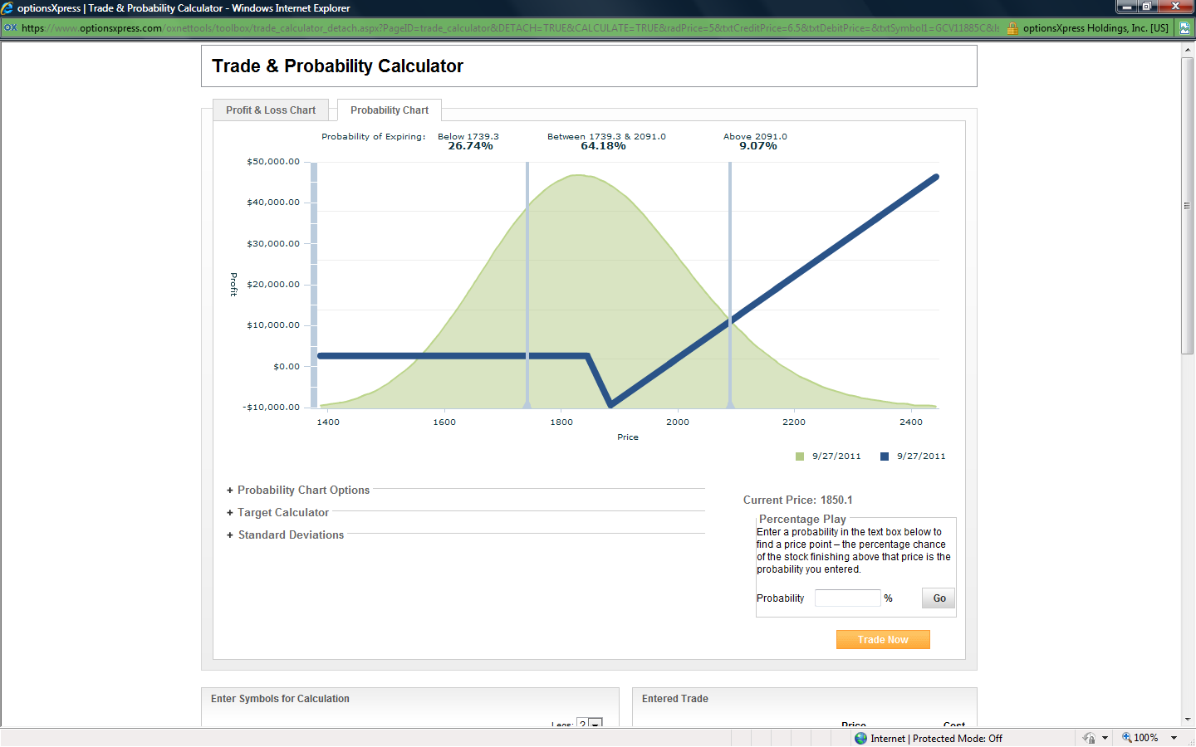
Gold
Call Ratio Back Spread

Slide 19
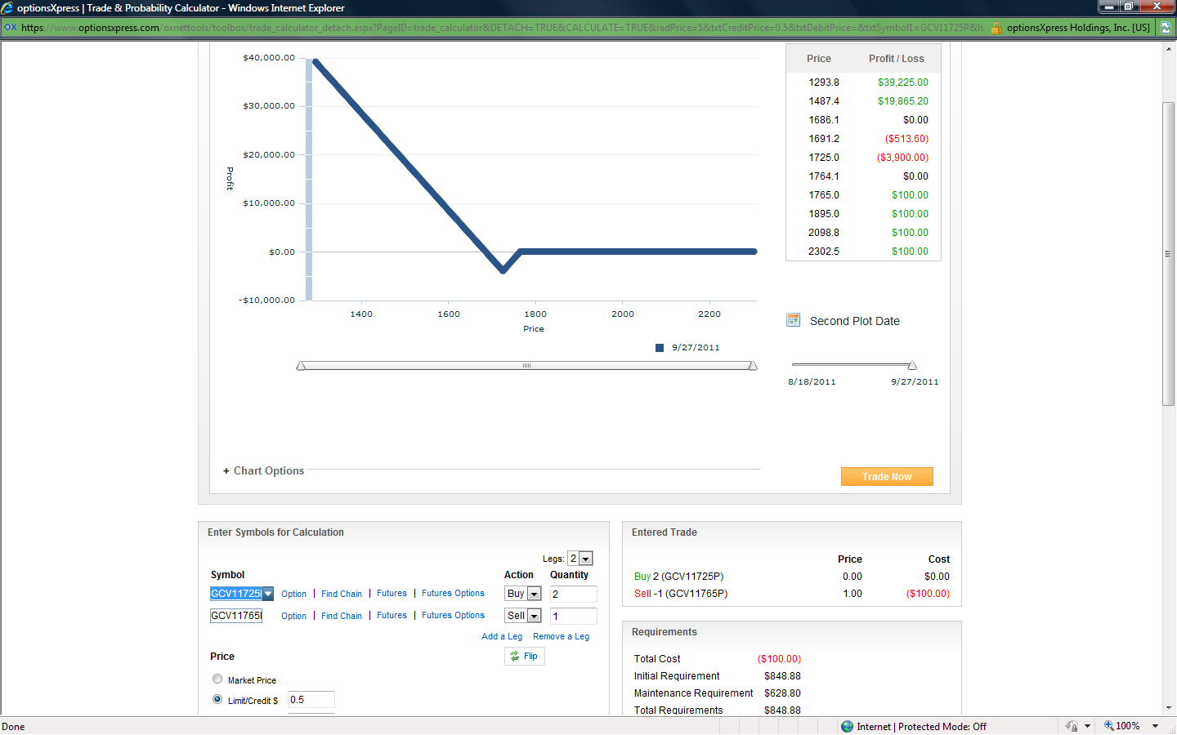
Gold
Put Ratio Back Spread
Notes:
Symbol Bid Ask IV
GCV11725P 13.70 17.50 25.42
GCV11765P 0.00 31.00 20.06

Slide 20
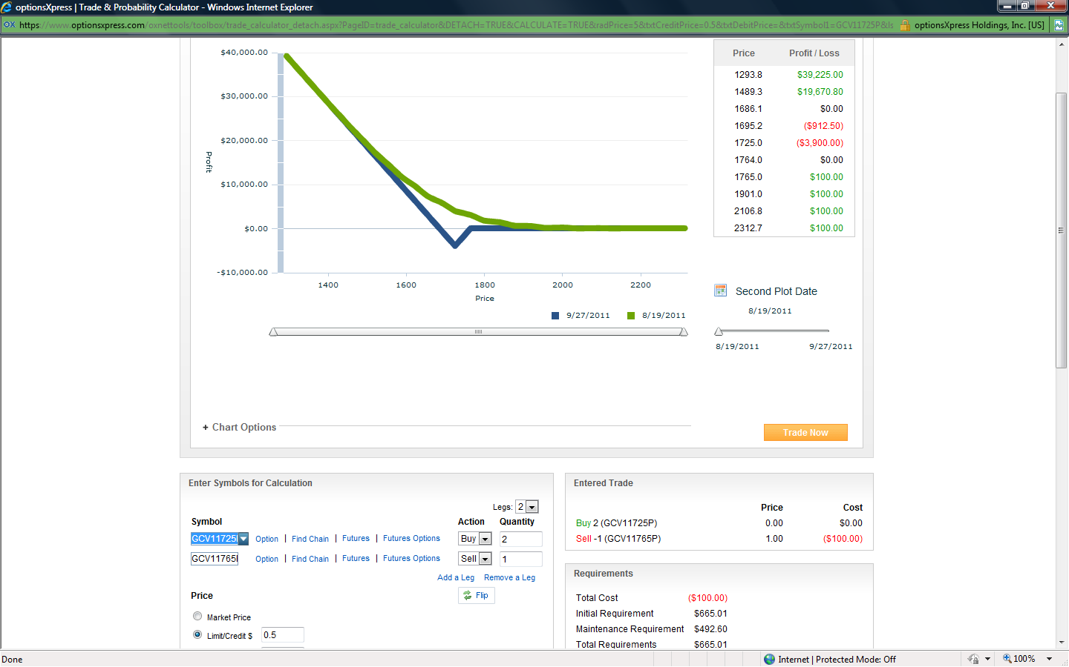
Gold
Put Ratio Back Spread

Slide 21
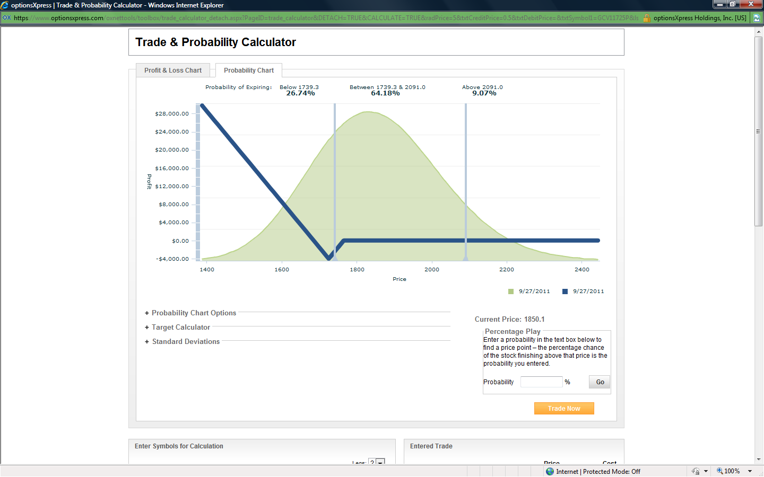
Gold
Put Ratio Back Spread

Slide 22
Good Luck & Good Trading!

