Slide 1
Portfolio Management…
What does it take to do it well?
By Ken Hodor
3/14/12

Slide 2
“Light bulb” moment
Very smart people use professional money managers.
  Some I know, thought they could do better
Can I expect to beat professional money managing teams taking care of all my $?

Slide 3
Become an expert at
Trading
Money management
Mastering emotions
Understand trading key asset classes
Willing to spend 10,000 hours developing expertise
Time management

Slide 4
Trading
Keep track of trading history
Must maintain consistency
Define and analyze trading strategy
  Know your expectancy
  Know your optimal f
Modify strategy
  To changing market conditions
  Improve returns on capital

Slide 5
Money Management
Goal assessment
  Age considerations
Risk assessment
  Health risk issues
    If I have an accident
    If my brain function declines
  Dedicated time allocation risks
  Other risks
    What is their defensive strategy?

Slide 6
Financial Advisors
Manage Money Managers
Asset allocation
Primary contact to client
  Coach client

Slide 7
Money Managers
Full time job
Run by multiple professionals
  Specializing in different asset classes
  Different skills and disciplines
  Administrative services
  …

Slide 8
Mutual Funds
Fees
  Front-end Load
  Back-end Load
  Management Fees
Returns comparable to various indexes
  Few ever beat their benchmark indexes

Slide 9
ETFs
These ARE the indexes mutual funds use as benchmarks
Fees
  Extremely low management fees –0.2% or less

Slide 10
Hedge Funds
Fees
  20-30% of gains
  2% of assets under management
Returns
  20%+ after fees
Reference on what it takes for a hedge fund
  : http://howdoyoustartahedgefund.com/wp-content/uploads/2011/12/Starting-a-hedge-fund-GrantThornton-Stonegate-Capital-Dec-2011.pdf

Slide 11
Ken’s Hedge Fund Checklist to enlist their help
Review performance history
  Profit factor
  Optimal f—f$
  Biggest drawdown
  Geometric gain
Explain strategy used—is it robust?
  All entries and exits defined
Money under management
  Can it continue to grow or is it too big for market?
Can we trust this group?

Slide 12
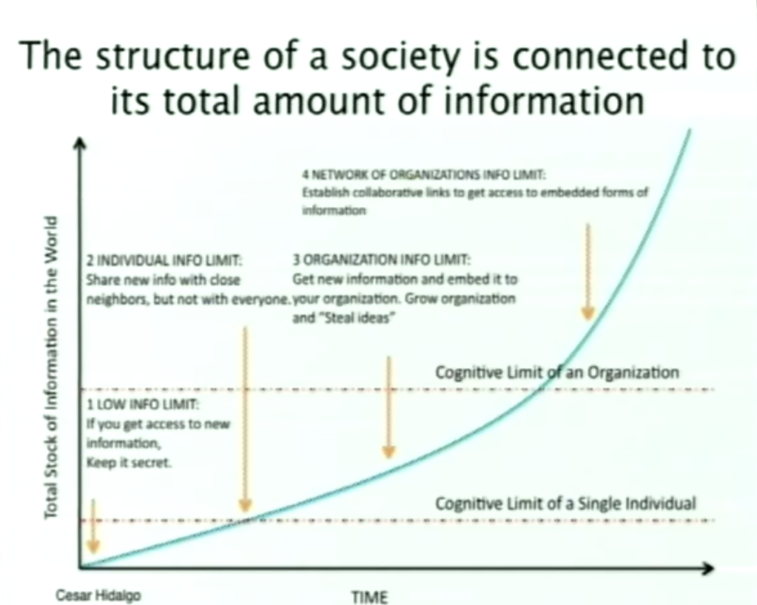
Individual’s Limitations

Slide 13
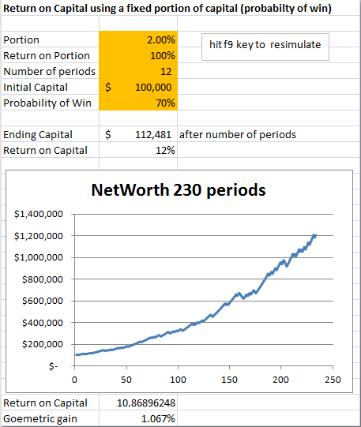

Slide 14
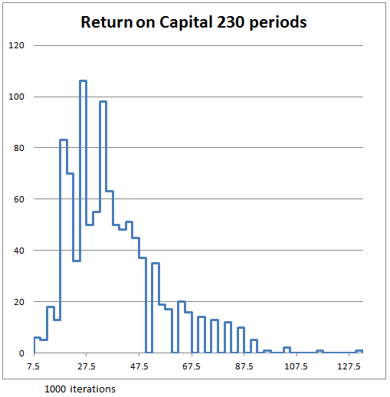
Monte Carlo Analysis
Hit f9 key 1000 times
Number of times
Multiple times 100%
Gain on original capital→

Slide 15
My (Ken’s) Opinion
While developing your skills to trade
Use simple checklist to find money managers
  Utilize many smart people spending 100% of their time managing money managers
Manage only a portion of your assets

Slide 16
Various possibilities
Total Portfolio Return
20% per year
Money Market Rate <1%
100% Myself
100% Money Mangers

Slide 17
Simple rule
Use 200-day moving average to move in and out of market
  Below 200-day moving average out of market
  Above 200-day moving average in market
Use this to call money managers and hold them to this rule

Slide 18
Diversify Portfolio Management
Manage a portion myself
Find effective money managers for the rest
  Optimal f money manager gets max of 10%
  Banks max 10%
  Other Money managers or ETFs get the rest
    Schwab
    Fidelity
    Merrill Lynch
    TDAmeritrade
    …

Slide 19
Conclusion
Keep majority of capital with highest ROC
Only change allocation when demonstrated better performance over 6 months or more
Utilize the strength of a team

Slide 20
References
http://en.wikipedia.org/wiki/Investment_management

