Slide 1
Exits are more important than
Entries
Hare Krishna Mitra
OC Traders

Slide 2
Entries and Exits
Fundamental based
Price action based
  Making a new high/low
  Failure to make a new low/high
  Value zone (support/resistance, buyer/seller concentration, supply/demand)
Indicator based
  Moving Average based
  Oscillator based
  Channel based
Hybrid
  Combination of price action and indicators
Random

Slide 3
Spend time formulating Exits
Novice Traders spend 80% of their analysis time fine tuning their entry techniques
Exit rules are often not clearly defined and are not based on proven money management principles
Stress should be given on formulating the exit rules (stop loss & profit taking)
Exits make you money not the Entries

Slide 4
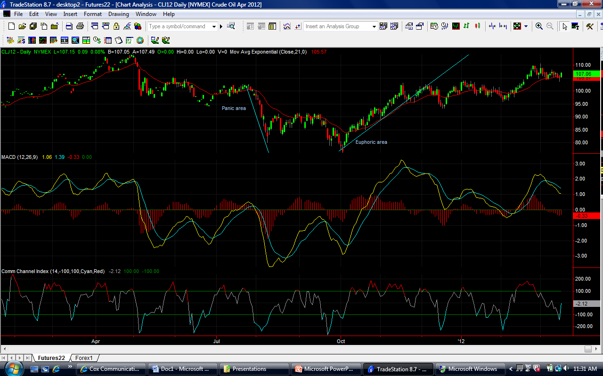
Crude Oil (Daily)

Slide 5
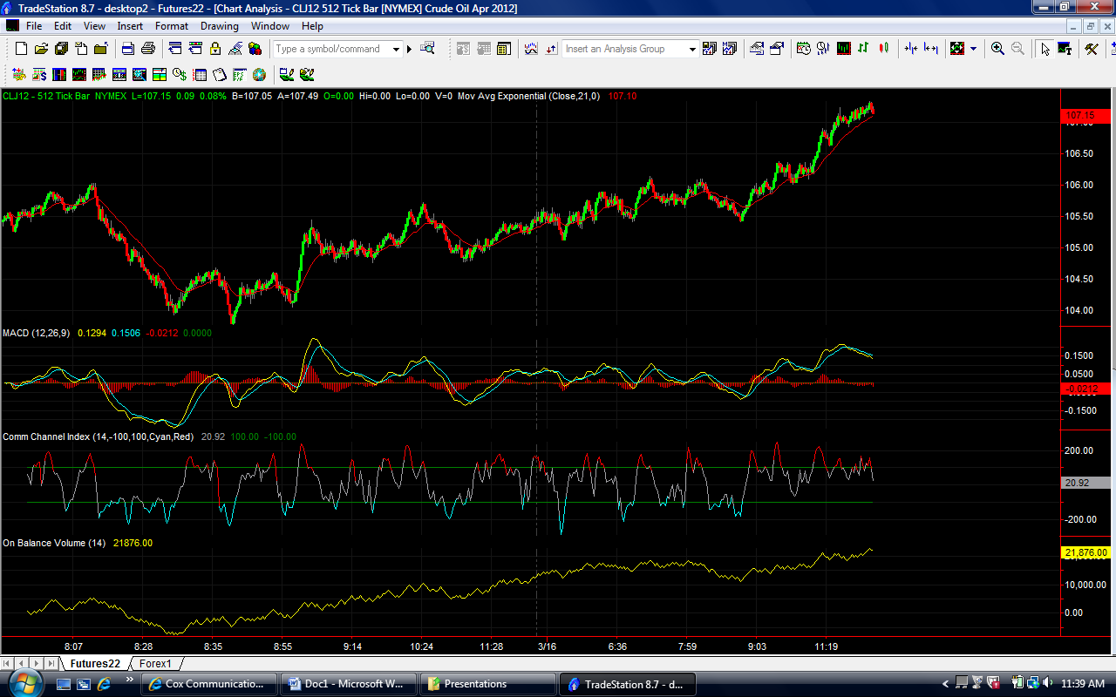
Crude Oil (Intra day)

Slide 6
Entry-Exit Game (eeGame)
Our fellow traders at FMT were given a sheet of paper with the time axis visible and not the price bars (chart)
They made selection for trade entry time and numbered those 1 through 12
Then it was decided that the odd numbers will be considered as long entries and even numbers as short entries
Now the price axis and the complete chart was made visible and the trade entries were noted down
Following pre defined exit rules, exit points were determined for each trade
The same procedure was repeated for inter-day swing trading with the exception that the odd numbers were considered as short entries this time

Slide 7
Entry / Exit Rules for eeGame
Entries are random
Exit Rules
  20 cents stop loss for Intra day
  $1.50 for inter day
  For long entry: when it fails to make a new swing high, exit
  For short entry: when it fails to make a new swing low, exit

Slide 8
Intra-day eeGame Results
Trade# | Entries |  | Exits | P/L
 | Long | Short
1 | 105.20 |  | 105.60 | 0.40
2 |  | 105.80 | 105.58 | 0.22
3 | 105.45 |  | 105.70 | 0.25
4 |  | 105.58 | 105.78 | -0.20
5 | 105.90 |  | 105.70 | -0.20
6 |  | 105.20 | 104.75 | 0.45
7 | 105.70 |  | 105.50 | -0.20
8 |  | 105.40 | 105.60 | -0.20
9 | 105.90 |  | 105.70 | -0.20
10 |  | 105.55 | 105.75 | -0.20
11 | 105.35 |  | 105.55 | 0.20
12 |  | 105.60 | 105.80 | -0.20
 |  | Total P/L per contract=$120 |  | $0.12

Slide 9
Inter-day eeGame Results
Trade# | Entries |  | Exits | P/L
 | Long | Short
1 |  | 112.00 | 113.50 | -1.50
2 | 98.00 |  | 96.50 | -1.50
3 |  | 105.00 | 87.00 | 18.00
4 | 85.00 |  | 83.50 | -1.50
5 |  | 98.50 | 86.00 | 12.50
6 | 85.00 |  | 90.50 | 5.50
7 |  | 91.00 | 85.50 | 5.50
8 | 87.00 |  | 102.00 | 15.00
9 |  | 99.00 | 100.50 | -1.50
10 | 102.50 |  | 101.00 | -1.50
11 |  | 98.00 | 99.50 | -1.50
12 | 101.00 |  | 99.50 | -1.50
Total P/L per contract = |  | $46,000 |  | $46.00

Slide 10
Analysis of Random entry trades
1. The inter-day random entry swing trades made $46 per crude oil contract which translates into $46,000.00 gross profit in a year! More than 150% ROI (considering a $30K acct. size)!
2. In intra-day trades we made $120.00 only
3. In both cases, out of total 12 trades, number of loosing trades were 7 and consecutive loosing trades were 4
4. Since the number of samples were limited to 12 only, the win : loss = 5 : 7. I think if we use a large sample and wide stop loss, it will converge to 50:50

Slide 11
Conclusion
Exits are more important than Entries
The results definitely make a case in favor of inter-day swing trading and not intra-day swing/scalp trading
A good entry will definitely make the outcomes better. But key to trading success is a good exit strategy based on money management principles

Slide 12
Many Happy Entries & Exits!

